Slide 1
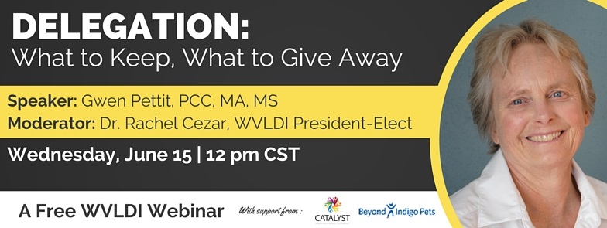
WVLDI

Slide 2

Welcome
Delegating:
What to keep- What to give away

Slide 3




Generous sponsors

Slide 4

Delegating:
What to keep-what to give away
Gwen Pettit , PCC, MA, MS
CATALYST Veterinary Practice Consultants, LLC
Gunnison, CO

Slide 5
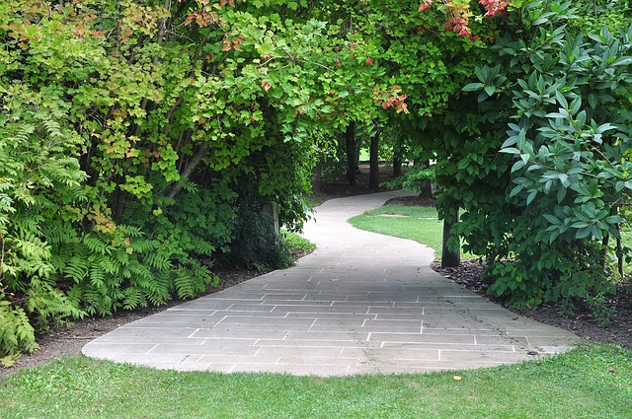
The secret way to simplify life
Why Delegate?
It is all about you

Slide 6

Today’s Topics
Key points on delegation
Understand how your beliefs impact delegation
Clarify your high value activities before delegating
Learn the delegation rules of Who, What and How
Resources
Q&A

Slide 7
Delegation is:
The secret to simplification
Key indicator of your organizational skills
Easy when you are clear on your high value activity
Difficult when you are not clear on important tasks

Slide 8
Why Delegate? For you
Frees up time
Increased satisfaction on tasks
Spend time on higher value activity
Leverage your time

Slide 9
Why Delegate? For others
Employee empowerment
Building leadership skills
Improves team performance
Personal satisfaction
Personal development

Slide 10
Group Poll
How many tasks or projects are you holding on to right now-that you could delegate to others?
A none
B 1-2
C 3-4
D 4 +
E too many to count

Slide 11

Beliefs drive actions
Going it Alone
What are your beliefs?
Based on past experience
Do you know your patterns?
Is this belief valid now?

Slide 12
Beliefs
Self sufficiency
Prove yourself to others
The helper syndrome
The perfectionist gene

Slide 13
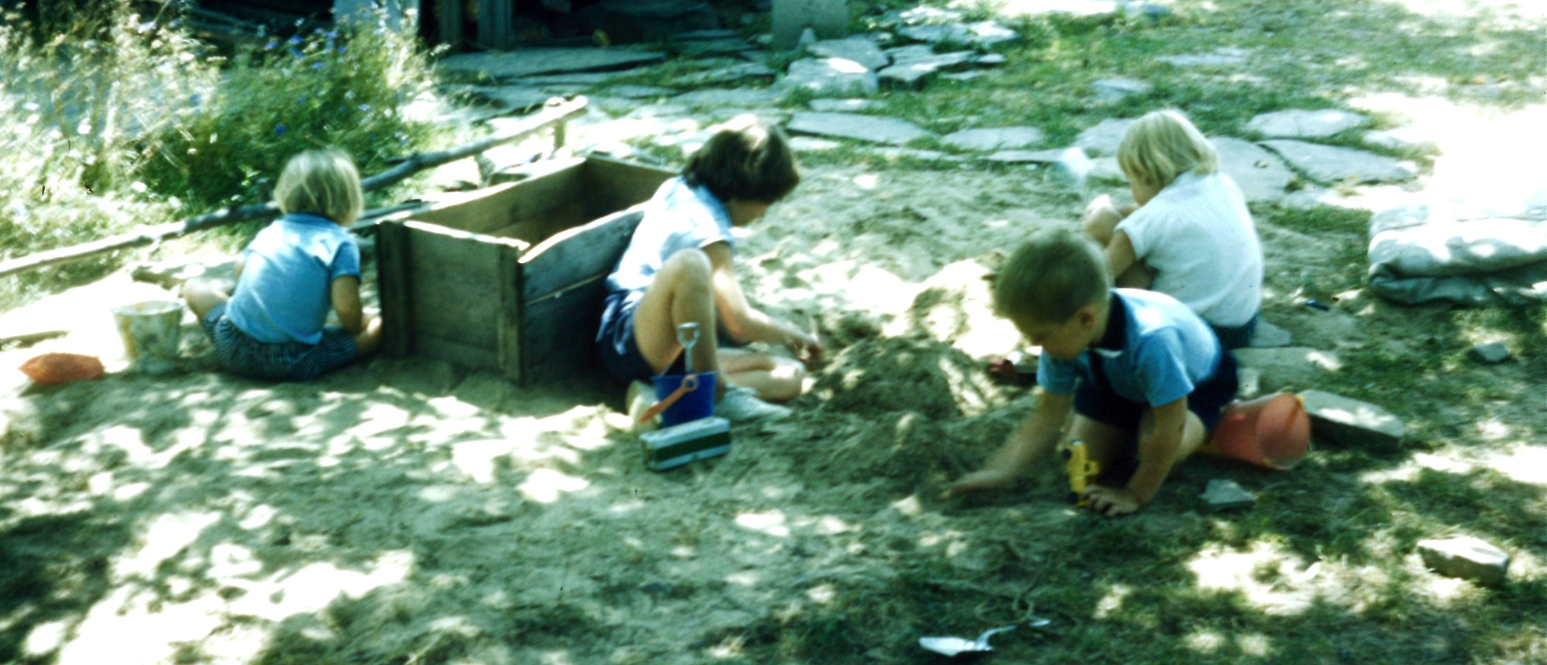
Is this Delegation?

Slide 14
Why people get stuck
No system to delegate
True cost of delegation avoidance
Seems easier to do than explain
Fast results
You trust yourself
Not aware of true cost of delegation avoidance
Time lost
Cost to you
Message sent to others
Opportunities lost

Slide 15

What is your passion?

Slide 16
Clarify High Value Activity
What do you do better than anyone else?
What are you trained for that no one else is?
What contributes to your goals, outcomes and results?
Where is your happy place?

Slide 17
Who is doing what job?

Slide 18
Three elements of delegation
What
Who
How

Slide 19
What to keep
High value activities
Unique to you
Skills or experience
Revenue producing
Goal oriented

Slide 20
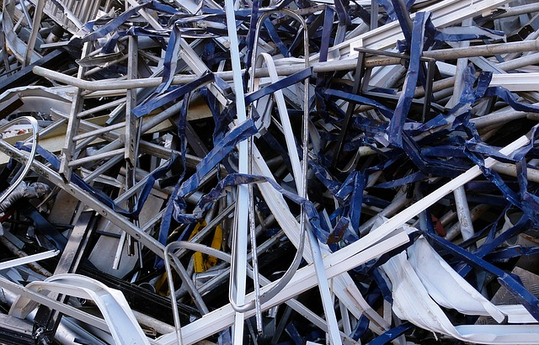
What To Give Away
Everything else !

Slide 21
Who to delegate to
Specific person
Match the task to skills
Building trust

Slide 22
Get a clear agreement
Main source of conflict
Unclear definitions
Roles
Expectations
Who is responsible for what

Slide 23
Who is driving?
Back seat?

Slide 24
How to delegate
Start small
Be specific in communication
Give feedback
Don’t micromanage
Be available for questions
Schedule progress checks

Slide 25
Delegation is a two way street
Other people will give you projects and problems
Be aware of your patterns
Who has responsibility ?
Who is the best person to do this?
Coaching Questions
Is this mine?
What am I saying no to?
Is this a high value activity?

Slide 26

Lost time?
A day with out delegation
Track your time for one day
Where did you spend your time?
What can you stop doing ?
What do you want to do more of?

Slide 27

Self Questions
Is this the best use of my time?
Can someone else do this?
Is this a high value activity for me?
Am I moving towards my overall purpose /goals?

Slide 28

Review
Delegation is a tool that will simplify your life
Clarify your high value activity
Be specific with who, what and how
Life is more fun when you delegate

Slide 29
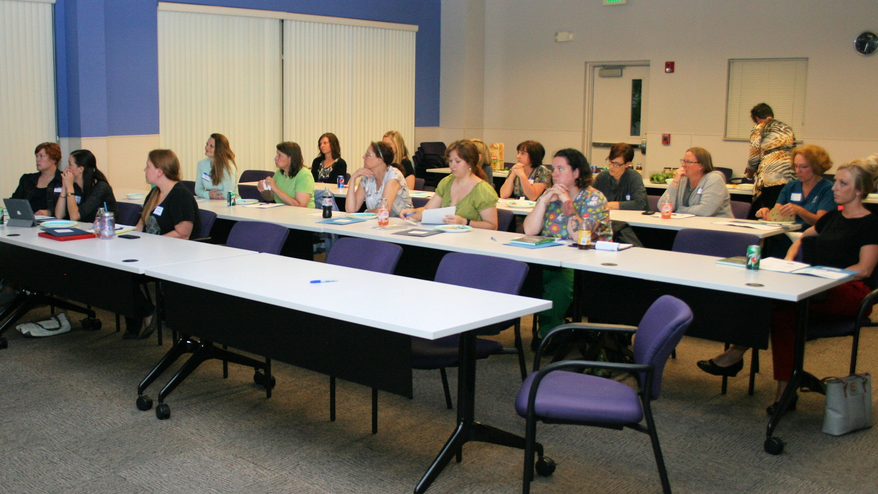
Upcoming WVLDI Events
Webinar: Team Communications July 13th
AVMA Presentations & Networking Events August 6th-8th

Slide 30

Thank you
Gwen Pettit , PCC, MA, MS
CATALYST Veterinary Practice Consultants, LLC
Gunnison, CO
www.catalystvetpc.com
303-717-6224
gpspiral@gmail.com

