Slide 1
Professional Etiquette;
Build your Career on it!

Slide 2
Welcome!
Thank you for attending

Slide 3
WVLDI Mission
To support women in seeking and achieving leadership, policy, and decision-making positions within all areas of professional veterinary activity.
WVLDI Vision
To develop leaders for the benefit of the profession and to deliver on the promise of veterinary medicine to society.

Slide 4
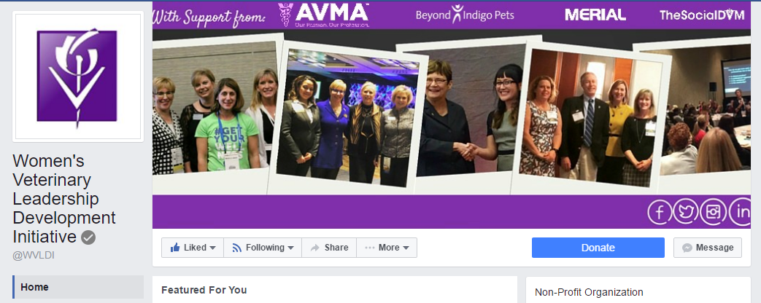
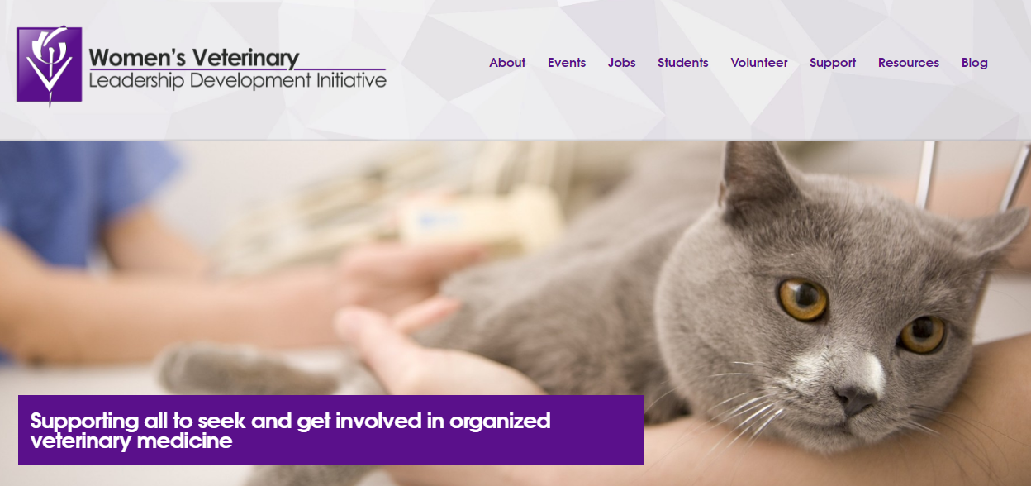
www.facebook.com/WVLDI/
www.wvldi.org

Slide 5
THANK YOU TO OUR 2017 SPONSORS AND PARTNERS
Foundational Partner
Platinum Sponsor
Gold Sponsor
Social Media Partner
Website Partner

Slide 6
Professional Etiquette; Build your Career on it! Rebecca Rose, CVT CATALYST Veterinary Practice Consultants Littleton, CO

Slide 7
Today’s Topics
What is Professional Etiquette?
Expectations
First Impressions
Engaging with clients & team
Writing correspondences
Confidentiality & patient information
Resources
Q&A

Slide 8
What is Professional Etiquette? Why is it “elusive?”

Slide 9
Expectations

Slide 10
First Impressions

Slide 11
Engaging with Teams

Slide 12
Engaging with Clients

Slide 13
Correspondences
Emails
Social Media
Text
Instagram
The LIST GOES ON!

Slide 14
Consider:
“Is this thoughtful or thoughtless?”
“Is this considerate or inconsiderate?”

Slide 15
Confidentiality & Patient Information

Slide 16
More Resources
WVLDI events
Classes in Communication
In-Hospital training with the team
Links in Handout

Slide 17
YOU GOT THIS!
Professional Etiquette
Expectations
First Impression
Clients & team
Correspondences
Confidentiality

Slide 18
Upcoming WVLDI Events
Webinar:
Emotional Intelligence;
Grow your Self-Awareness
September 7th
2017 Fall Series
Know your Self-Worth
Having the Confidence to Negotiate or Walk-Away

Slide 19
THANK YOU FOR ATTENDING!
Q&A

