Slide 1
WVLDI

Slide 2
Welcome!

Slide 3
Generous sponsors

Slide 4
Team Communications; Key to all success
Hosted by WVLDI
Presented by Rebecca Rose, CVT
July 13th, 2016

Slide 5
Survey Says……
Veterinary technicians and team members were asked:
“Looking to the next 5 years, please select THREE issues you believe will most negatively affect your job?”
Nearly 3000 respondents!
25% replied: “Underdeveloped communication skills (individual or team members)”

Slide 6
Today’s 4 Topics
Be aware of body language
Engage in active listening
Show appreciation
Write it down

Slide 7
Body Language
What percentage is Non-Verbal?
Dr. Albert Mehrabian, author of Silent Messages, conducted several studies on nonverbal communication. He found that 7% of any message is conveyed through words, 38% through certain vocal elements, and 55% through nonverbal elements (facial expressions, gestures, posture, etc). Subtracting the 7% for actual vocal content leaves one with the 93% statistic.

Slide 8
Body Language
Actions speak louder than words!
Facial expressions
Body movements and posture
Gestures
Eye contact
Touch
Space
How you say it!

Slide 9
Body Language
In each conversation, what is your body saying?
Alignment with your words?
Contradicting your words?
Expressing discontent or frustration?
Showing impatience?
Be aware of your body language.

Slide 10
Active Listening

Slide 11
Simple Formula….. How many ears? How many mouths?

Slide 12
Active Listening
Strong eye contact
Positive head nodding
Appropriate environment
Paraphrasing/Mirroring
Avoid distracting behavior
Facing or leaning toward speaker

Slide 13
There are three components to active listening:
1. Receive the message
2. Process the message
3. Respond to the message

Slide 14
Best example of active listening
Ralph Johnson, Executive Director
Colorado Veterinary Medical Association

Slide 15
Challenge yourself
Focus during one conversation to listen
Really LISTEN!
Once a day, for the next week

Slide 16
Why show appreciation?
Why is appreciating people for their efforts so important?
This goes back to the meaning of life meaning of life and finding out what you want. People are programmed to want to exist, with their feelings guiding them towards the path of “most existence”. Some of these ways of existing include existence in other people’s memory, existence by altering history, and existence by contributing something to society.
Why you should show appreciation; http://www.whatithinkabout.com/why-you-should-show-appreciation/

Slide 17
Show Appreciation
Simple, sincere “Thank you.”
Well Done!
Small, meaningful gift.
“Just Checking In,” outreach.
You ROCK!
Reciprocate, a favor for a favor.

Slide 18
Show Appreciation
Prior to getting into the meat of your conversation, be sure to express your thanks for the other individual’s time. Time is an extremely precious resource, and it important to be respectful and considerate of that. Also, complement or recognize any positive contribution they are making. Appreciation and praise can go a long way towards building good rapport.
Royale Scuderi, Lifehack
http://www.lifehack.org/articles/communication/9-tips-to-improve-communication-skills.html

Slide 19
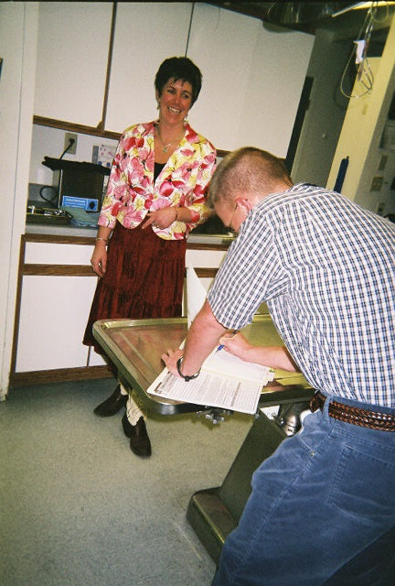
Write it down
Benefits of writing it down include
ACCURACY
RESPECTFUL
LESS MISTAKES
TIME EFFICIENT!

Slide 20
Write it down
I don't understand why people pride themselves on being able to keep stuff in their heads. I like to use my brain space for creative and progressive thinking, not my to-do list. Dare I say it ... use pen and paper! However you do it, record takeaways from the conversation so you don't have to have it again. I do find the act of actually writing with pen and paper helps me remember better.
Kevin Daum, Inc. http://www.inc.com/kevin-daum/8-ways-to-improve-your-communication-right-now.html

Slide 21
Write it down
Sticky notes/pad of paper
Text message yourself
Send yourself an email
Google/Outlook calendar
Messages over the phone
Prefer the duplicate forms, at all phones….
While on the phone, explain you are writing
Client’s appreciate the gesture!

Slide 22
You GOT this!!
Being aware of body language
Engaging in active listening
Showing appreciation
Writing it down

Slide 23
Generous sponsors

Slide 24
Upcoming WVLDI Events
Western Veterinary Conference Women’s Summit in July
AVMA Continuing Education & Social Gatherings in August
Southwest Veterinary Symposium in September
Veterinary Hospital Managers Association in October

Slide 25
THANK YOU FOR ATTENDING!
Q&A

Slide 26
Rebecca Rose, CVT
CATALYST Veterinary Practice Consultants, LLC Gunnison, CO
www.catalystvetpc.com
303-717-6224
rebeccarosecvt@gmail.com

